Slide 1
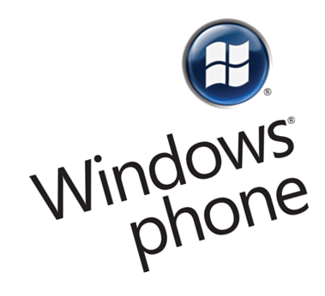
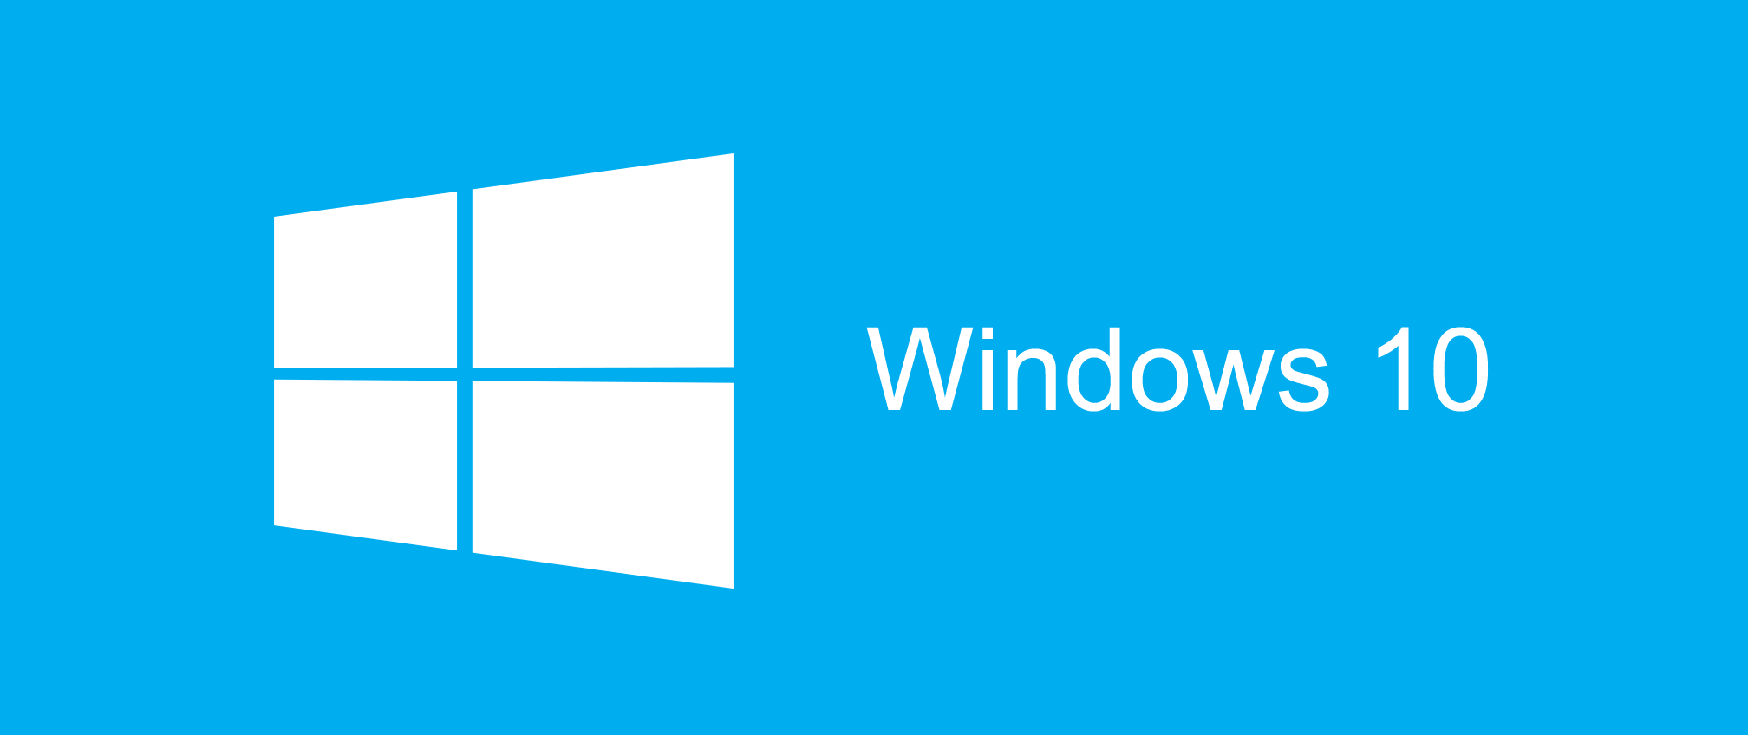

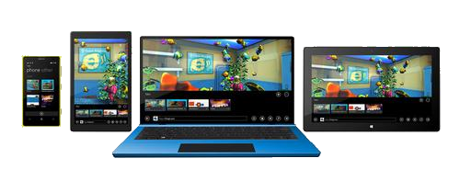
Windows-based Applications History

Slide 2

Table of Contents
History of Windows OS for Desktop
From Windows 3.0 to Windows 10
History of Windows OS for Mobile
From Windows CE to Windows Mobile to Windows Phone to Windows 10 Mobile
Ways to develop Windows Applications
MFC, WinForms, WPF
Windows Universal Apps (Win 8.1)
Universal Windows Platform (Win10)
Unity3D, Xamarin, Apache Cordova

Slide 3
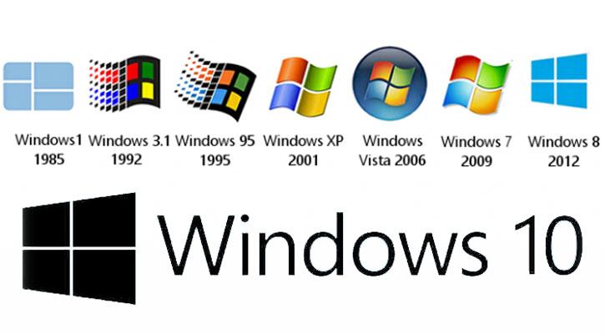
History of Windows OS

Slide 4
Windows OS History
Domestic Use
MS-DOS
Windows 1
Server
Corporate Use
Windows 2
Windows 3
NT Server 3
Windows 3.1 and 3.11
Windows NT 3
NT Server 4
Windows NT 4
Windows 95
Windows 98
Windows ME
Server 2000
Windows 2000
Server 2003 (+R2)
Windows XP
Windows XP Home
Server 2008
Windows Vista
Windows Vista Home
Server 2008 R2
Windows 7
Windows 7 Home
Server 2012
Windows 8
Windows 8 Home

Slide 5

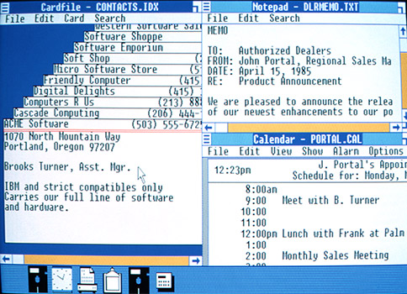
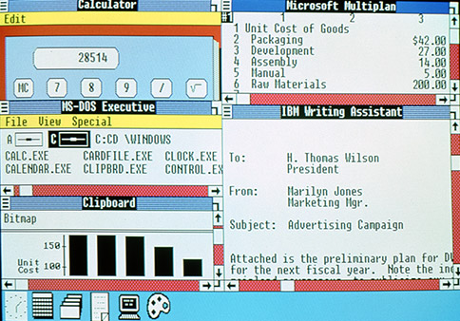
First Windows Versions
1975–1981: Microsoft boots up
MS‑DOS
1982–1985: Introducing Windows 1.0
1987–1990: Windows 2.0–2.11 – More windows

Slide 6
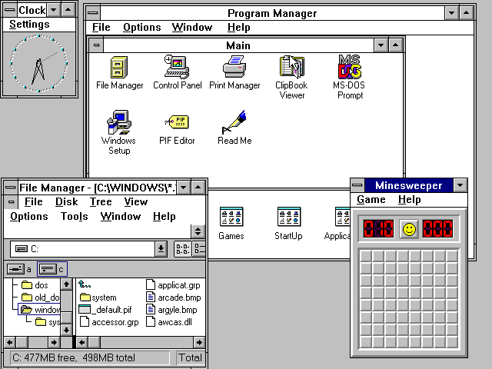
Windows 3.0
Windows 3.0
Release: May 1990
Support end: Dec 2001
Able to compete with
Macintosh UI
Multimedia upgrade kit
CD-ROM
Sound card

Slide 7
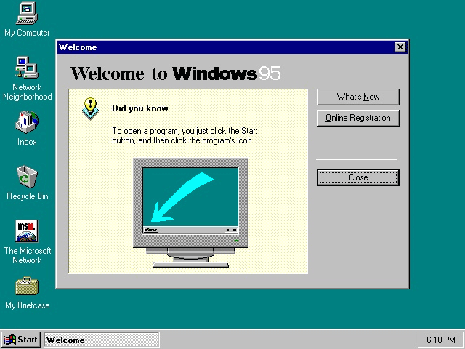
Windows 95
Windows 95
Release: Aug 1995
Support end: Dec 2001
Consumer oriented
Key new features:
Win32 API
The “Start” button
The taskbar

Slide 8
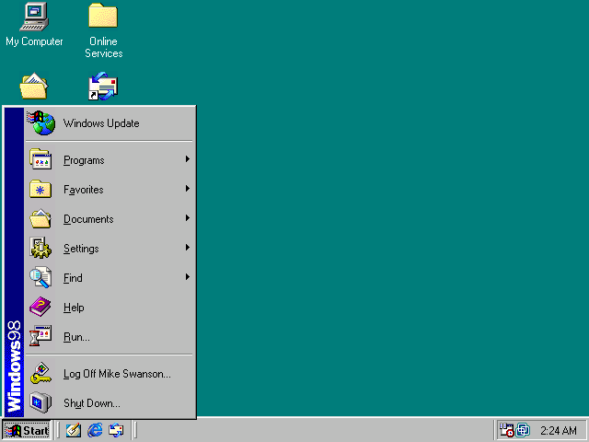
Windows 98
Windows 98
Release: June 1998
Support end: July 2006
Key new features
Windows Driver Model
Wider support for USB
ACPI support – Standby and Hibernate states

Slide 9
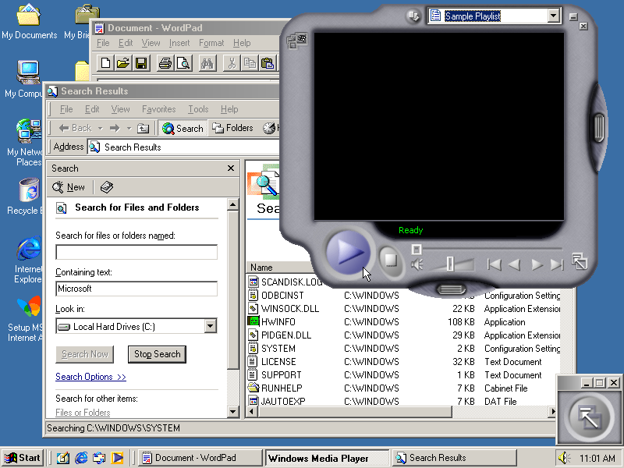
Windows Millennium Edition
Windows ME (Mistake Edition)
Release: Sep 2000
Support end: Jul 2006
Main target home PC users
Key new features
Customizable Windows Explorer toolbars
Personalized menus
Autocomplete in Windows Explorer address bar

Slide 10
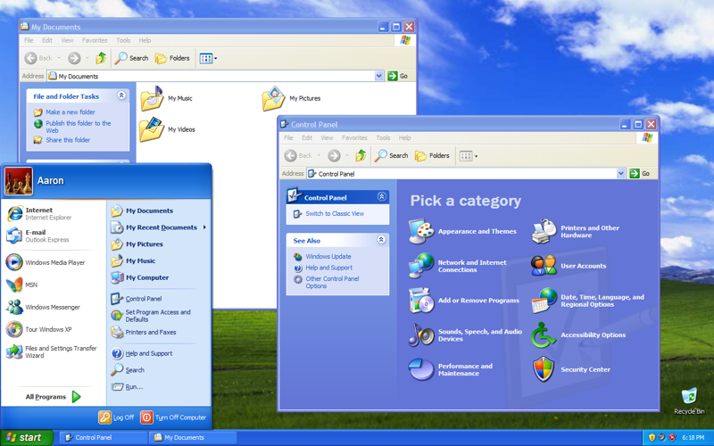
Windows XP
Windows XP
Release: Dec 2001
Support end: April 2014
Improved hardware support
Key new features
Windows Product Activation
Internet Connection Firewall
Internet Connection Sharing
Remote Desktop

Slide 11
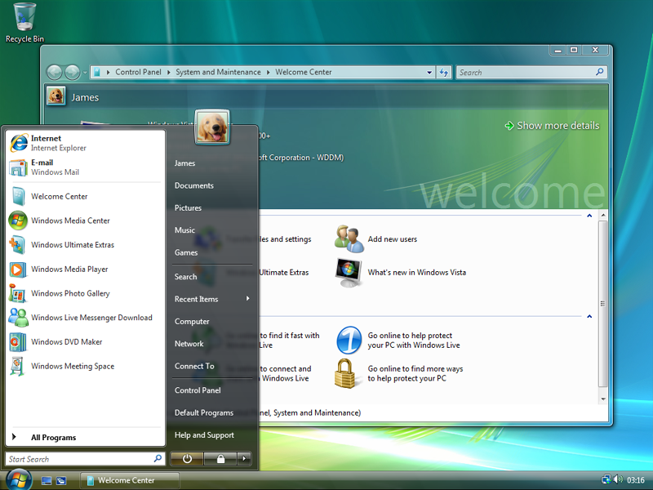
Windows Vista
Windows Vista
Release: Jan 2007
Support end: April 2017
Improved security
Kew new features
Improved UI – Windows Aero
Windows Search
Increased level of communication between home network machines

Slide 12
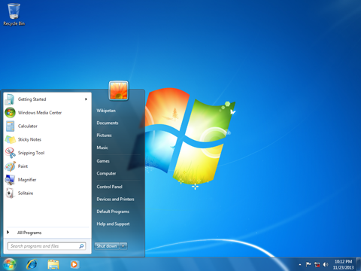
Windows 7
Windows 7
Released: Oct 2009
Support end: Jan 2020
Key new features
Improved performance on multi-core CPUs
Taskbar “pin application”

Slide 13
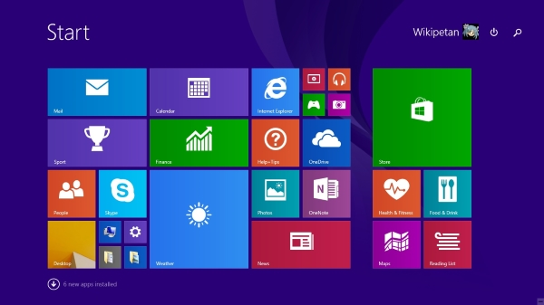
Windows 8
Windows 8
Released: Oct 2012
Support end: Jan 2023
Metro Design
Key new features
Windows Store
Improved mobile UI
New start screen
USB 3.0 support

Slide 14
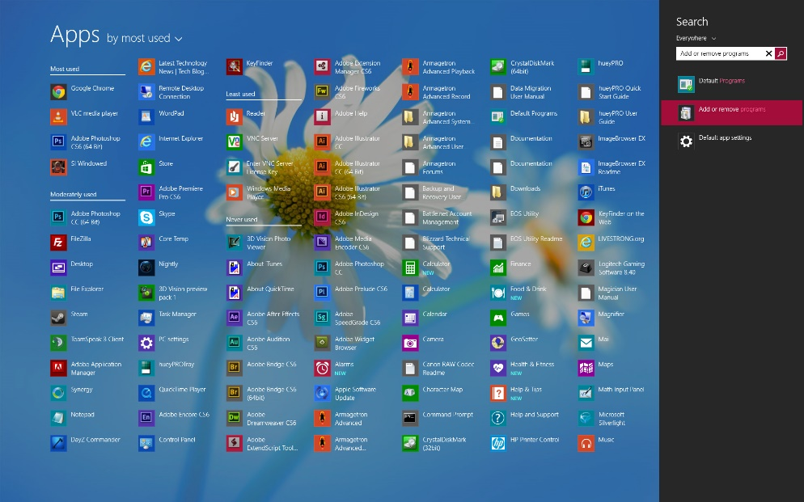
Windows 8.1
Windows 8.1
Released: Oct 2013
Support end: Jan 2023
Major update to Win 8
Key new features
All Apps view
Improved window snapping
Tighter OneDrive integration
Support for 3D printing using NFC tags

Slide 15
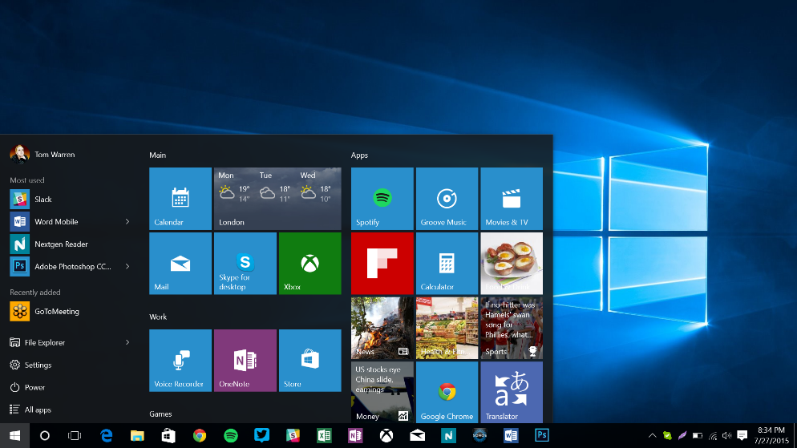
Windows 10
Windows 10
Released: Jul 2015
Support end: Oct 2025
Free for Win 8 users
Key new features
Harmonized UX between all devices
Universal Windows Platform
Shared code and UI for desktop and mobile
Responsive design

Slide 16
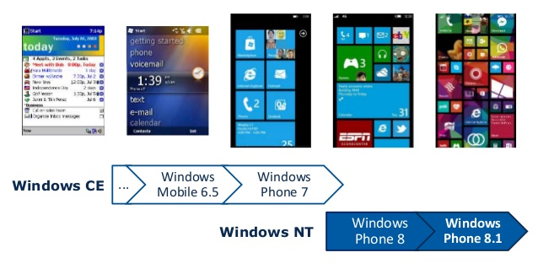
History of Windows OS for Mobile

Slide 17
Windows Mobile History

Slide 18
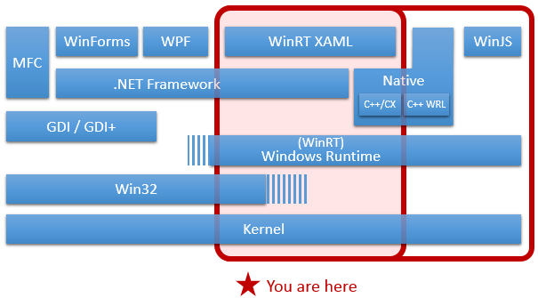
Ways to develop Windows Applications

Slide 19
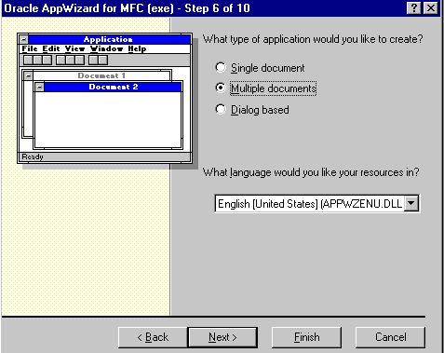
Microsoft Foundation Classes
C++ wrapper for the Windows API

Slide 20
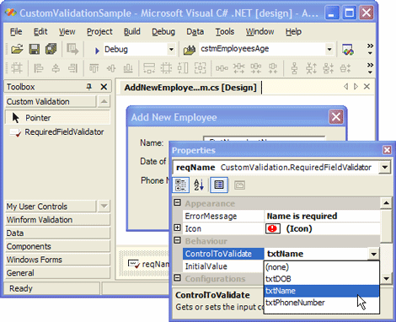
Windows forms
GUI class library
Replaces the Microsoft Foundation class library
The first C# UI framework
Event driven applications
Access to native Windows User Interface Controls
Better exposure of the Win32 API than MFC
The Control class
Location, size, color, font, text, click, drag

Slide 21
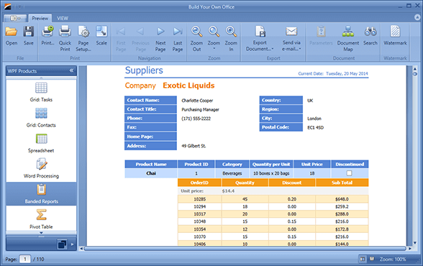
WPF
XAML based
Similar idea to HTML
Uses DirectX and Direct3D
Provides data binding
Rich media support
Vector and raster images, audio and video
Supports animations
Silverlight is a subset of WPF
As replacement of Flash, later for mobile apps

Slide 22
History of Windows Universal
2010 – Windows Phone 7
Mid-2011 – public beta of Windows 8
Mid-2012 – publicly released Windows 8
Designed for touch
Microsoft’s OS was headed for the tablet
April 2014 – Windows Universal Apps
Convergence of Windows 8.1 and WP 8.1
Create applications that target the phone and tablet and share a single code base
July 2015 – Universal Windows Platform (UWP)
As part of Windows 10 and Windows 10 Mobile

Slide 23
Windows 8.1 Universal Concepts
Develop a universal Windows app that targets Windows and Windows Phone
Share: code, user controls, styles, strings, and other assets between the two projects
Linked files between projects
Conditional compilation with preprocessor directives
#if WINDOWS_APP
// run Windows specific code
#elif WINDOWS_PHONE_APP
// run Windows Phone specific code
#endif

Slide 24
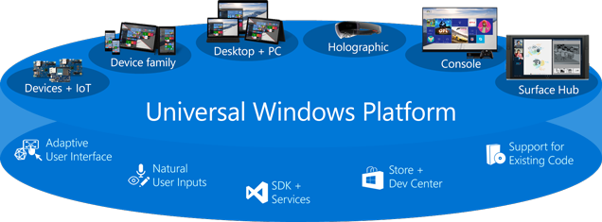
Universal Windows Platform
Released 2015
Targets device families, not an OS
One Store for all devices
Common UI
Responsive controls
Same UI code used for both mobile and desktop

Slide 25
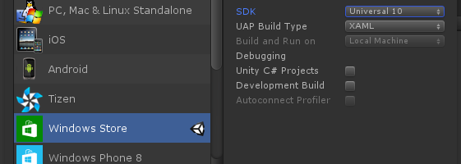
Unity3D

Slide 26
Xamarin

Slide 27
Windows-based Applications
http://academy.telerik.com

